Slide 1
Opioid Treatment Basics for Counselors
Thomas E. Freese, PhD
Pacific Southwest Addiction Technology Transfer Center UCLA Integrated Substance Abuse Programs
Semel Institute of Neuroscience and Human Behavior
UCLA David Geffen School of Medicine

Slide 2
Commonly Abused Opioids
Diacetylmorphine (Heroin)
Hydromorphone (Dilaudid)
Oxycodone (OxyContin, Percodan, Percocet, Tylox)
Meperidine (Demerol)
Hydrocodone (Lortab, Vicodin)
Notes:
1. While most patients abuse heroin, there are several other opioids that can be abused. This list is continued on the next slide, and it is not meant to be exhaustive. Note that all of these opioids exert a mu agonist effect.

Slide 3
Commonly Abused Opioids (continued)
Morphine (MS Contin, Oramorph)
Fentanyl (Sublimaze)
Propoxyphene (Darvon)
Methadone (Dolophine)
Codeine
Opium
Notes:
1.

Slide 4
Talking to patients about addiction treatment approaches
Medical
Recovery
Spiritual
Psychological
Behavioral

Slide 5
ADDICTION AS A CHRONIC ILLNESS
Chronic relapsing condition that
may lead to severe complications
and death.

Slide 6
ADDICTION AS CHRONIC DISEASE: IMPLICATIONS
It is treatable but not curable.
Adjustment to diagnosis is part of patient’s task.
There is a wide spectrum of severity.
Retention in treatment is key.
Best treatment is integrated.

Slide 7
Opioid Dependence Treatment Goals
Help patients to stop using opioids
Provide protection against the risk of overdose and death
Teach skills to cope with cravings and life stressors
Medications, most likely given over an extended period of time, should be the mainstay of opioid dependence treatment
Treatment should be focused on the many pathways to recovery
SOURCE: Slide courtesy of Dr. Adam Bisaga, PCSS-MAT Webinar, February 2014.
7
Notes:
Opioid addiction is a chronic disease that often involves cycles of relapse and remission and requires long-term treatment with a combination of psychosocial and pharmacological therapies (ASAM, 2013).

Slide 8
The Role of Medication in Treatment of Opioid Dependence
Detoxification from opioids without pharmacological support afterwards remains the dominant model of treatment
Medications to prevent relapse are not routinely offered after detoxification
First weeks following detoxification are the most dangerous phases of opioid dependence, with a significant risk of overdose and death
SOURCE: Slide courtesy of Dr. Adam Bisaga, PCSS-MAT Webinar, February 2014.
8
Notes:
1st Bullet: Despite decades of experience and evidence to the contrary
2nd Bullet: Result of an emphasis on being opiate- (medication-) free as the treatment goal rather than on the treatment as protection against negative consequences
3rd Bullet: Pharmacological assistance to prevent overdose is essential during this period ; It is imperative that either agonist or antagonist is offered to individuals who want to stop using opiates; Individuals who decide to undergo detoxification are in an ideal position to have a trial of antagonist to prevent relapse

Slide 9
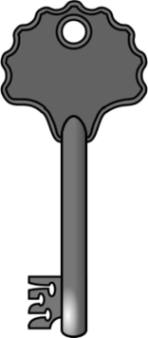
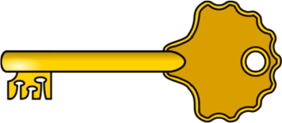
How Do Medications for Opioid Addiction Work?
Opioid
Full Agonist
Effect
(e.g., methadone)
Partial Agonist
(e.g. buprenorphine)
Antagonist
(e.g. Naloxone)
Dose of Opioid
Notes:
9
**ANIMATIONS**
This slide graphically depicts the different types of opioids (whether they are prescribed medications such as Vicodin or methadone, or illicit substances like heroin).
Move forward to reveal first line (full agonist)
Full agonists (e.g., heroin, opium, Vicodin, methadone, etc.) fully activate the receptors so that the more you use, the more effect you experience. If someone continues to use, they will eventually experience overdose and, possibly, death.
The following metaphor may be helpful in explaining the differences between the types of opioids:
Opioid agonists work like having the right key to a door. You put the key in the lock, the lock turns and the door opens completely.
Move forward to reveal the next line (antagonists)
Opioid antagonists (e.g., naltrexone, naloxone) fill the receptors and block the action of other opioids. If the person has used an opioid agonist, the antagonist will replace it on the receptor and the person will experience withdrawal. If the person is stable on an antagonist, and uses another opioid, the antagonist will block the effects, preventing the user from experiencing the high.
The door metaphor continued:
Opioid antagonists work like having the wrong key to a door. You put the key in the lock; the door remains locked and will not open. Additionally, since the key is in the lock, no other key can be put in the lock (even if it is the right key for that door) until the wrong key is removed.
Move forward to reveal the last line (partial agonists)
Opioid partial agonists (e.g., buprenorphine) produce moderate opioid effects. Its maximal opioid effects are less than that of full agonists, and reach a ceiling where higher doses do not result in increasing effect. In other words, after a certain point, taking more of the opioid will not produce any greater effect. This ceiling effect is particularly true for the euphoric effects and the respiratory suppression.
The door metaphor continued:
A partial agonist works like having the right key to a door, but the chain is on the door. You put the key in the lock, the lock turns and the door opens, but the chain prevents the door from opening fully.

Slide 10
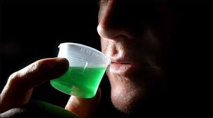
Methadone

Slide 11
Methadone Maintenance
Evidence-based treatment using the medical model
Includes interdisciplinary care, mandated counseling
Includes behavioral interventions, testing
Includes diversion control plans

Slide 12
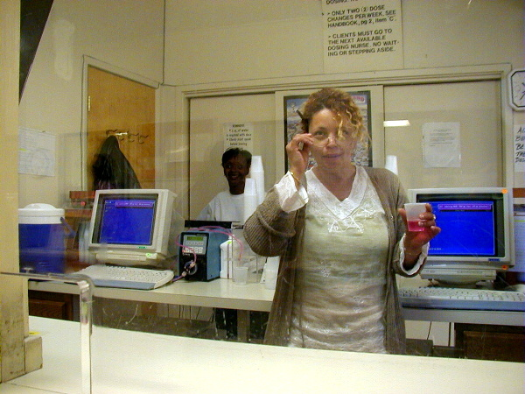
THE DOSING WINDOW

Slide 13
Treatment Outcome Data
4-5 fold reduction in death rate
reduction of drug use
reduction of criminal activity
engagement in socially productive roles
reduced spread of HIV
excellent retention
(see: Joseph et al, 2000, Mt. Sinai J.Med., vol67, # 5, 6)

Slide 14
Crime among 491 patients before and during MMT at 6 programs
Crime Days Per Year
Adapted from Ball & Ross - The Effectiveness of Methadone Maintenance Treatment, 1991

Slide 15
HIV CONVERSION IN TREATMENT
HIV infection rates by baseline treatment status. In treatment (IT) n=138, not in treatment (OT) n=88
Source: Metzger, D. et. al. J of AIDS 6:1993. p.1052

Slide 16
Four questions patients ask:
How is methadone better for me than heroin?
What is the right dose of methadone for me?
How long should I stay on methadone?
What are the side effects of methadone?

Slide 17
How is methadone better than heroin?
Legal
Avoids needles
Known amount ingested

Slide 18
Methadone Simulated 24 Hr. Dose/Response At steady-state in tolerant patient
“Loaded”
“High”
“Abnormal Normality”
Dose Response
Normal Range “Comfort Zone”
Subjective w/d
“Sick”
Objective w/d
Time
0 hrs.
24 hrs.

Slide 19
How is methadone better than heroin?
Legal
Avoids needles
Known amount ingested
Slow onset: no “rush”
Long acting: can maintain “comfort” or normal brain function
Stabilized physiology, hormones, tolerance

Slide 20
Four questions patients ask:
How is methadone better for me than heroin?
What is the right dose of methadone for me?
How long should I stay on methadone?
What are the side effects of methadone?

Slide 21
Individualized dose:
Control of withdrawal symptoms
Control of craving
Also some blocking effect (deterrent)
Not high enough to be sedating
There is a proven dose/effect relationship to outcome

Slide 22
Ref: J. C. Ball, November 18, 1988
Slide adapted from Tom Payte

Slide 23
Four questions patients ask:
How is methadone better for me than heroin?
What is the right dose of methadone for me?
How long should I stay on methadone?
What are the side effects of methadone?

Slide 24
How long?
As long as shows benefit.
Improved function over baseline
Reduction of use of opioids over baseline
Dismal relapse rate when MMT stopped.

Slide 25
Relapse to IV drug use after MMT 105 male patients who left treatment
Percent IV Users
Treatment Months Since Stopping Treatment
Adapted from Ball & Ross - The Effectiveness of Methadone Maintenance Treatment, 1991
Opioid Agonist Treatment of Addiction - Payte - 1998

Slide 26
Outcome of detoxifications :
Long-term no better than short after detox is over.
Most patients relapse within six months.
Ref: Sees et al.

Slide 27
Four questions patients ask:
How is methadone better for me than heroin?
What is the right dose of methadone for me?
How long should I stay on methadone?
What are the side effects of methadone?

Slide 28
Side effects:
Methadone side effects are similar to side effects of other opioids that are taken for a long time.
More constipation that with short-acting opioids.
Sweating may increase
Cardiac risk: associated with rare Torsade arrhythmia
Hypogonadism, sexual dysfunction

Slide 29
Summary to four questions:
Why methadone? Stabilizes the brain and body, allowing recovery.
What dose? Individual dose according to symptoms.
How long? As long as needed.
Side effects? Important to know about them. Generally fewer than uncontrolled opioid use disorder.

Slide 30
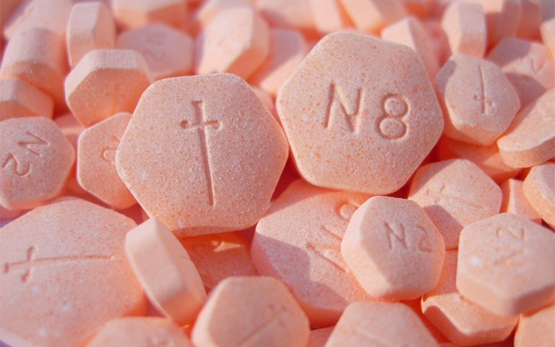
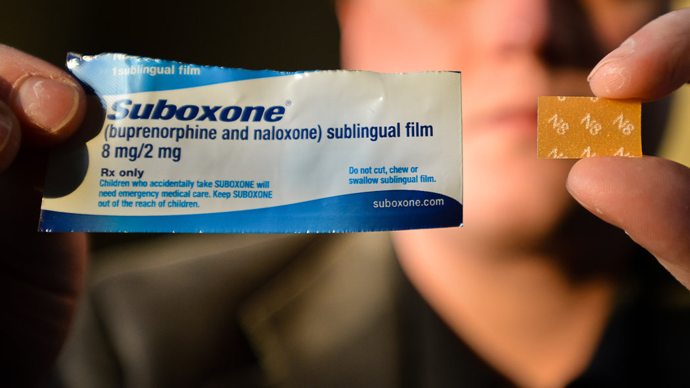
Buprenorphine/Naloxone

Slide 31
How Does Buprenorphine Work?
Partial Opioid Agonist
Produces a ceiling effect at higher doses
Has effects of typical opioid agonists—these effects are dose dependent up to a limit
Binds strongly to opiate receptor and is long-acting
31
Notes:
31

Slide 32
Research about Buprenorphine
Buprenorphine is marketed for opioid treatment under the trade names of Subutex® (buprenorphine) and Suboxone® (buprenorphine/naloxone)
Over 25 years of research
Over 5,000 patients exposed during clinical trials
Proven safe and effective for the treatment of opioid addiction
32
Notes:
32

Slide 33
Research about Buprenorphine
Clinical trials have established the effectiveness of buprenorphine for the treatment of heroin addiction. Effectiveness of buprenorphine has been compared to:
Placebo (Johnson et al. 1995; Ling et al. 1998; Kakko et al. 2003)
Methadone (Johnson et al. 1992; Strain et al. 1994a, 1994b; Ling et al. 1996; Schottenfield et al. 1997; Fischer et al. 1999)
Methadone and LAAM (Johnson et al. 2000)
33
Notes:
Buprenorphine was developed by a pharmaceutical company called Reckitt Benckiser. They had exclusive marketing rights until fall 2009, and distribute the medication as:
Subutex® = a sublingual tablet containing buprenorphine hydrochloride only
Suboxone® = a sublingual tablet containing both buprenorphine hydrochloride and naloxone hydrochloride in a 4:1 ratio
Reckitt Benckiser’s exclusive rights expired in fall 2009, so generic versions of the medication may become available in the future.
Buprenorphine-naloxone is the focus of U.S. marketing efforts, even though both formulations are available in the U.S.
The basic pharmacology, pharmacokinetics, and efficacy of the combination product are the same as the mono-product. Buprenorphine-naloxone has a ceiling effect at higher doses, blocks the effects of other opioid agonists, binds strongly to the opioid receptor, and is long acting.
These medications have a tremendous amount of research behind them to show that they are both safe and effective in the treatment of opioid addiction.

Slide 34
Advantages of Buprenorphine/Naloxone
Combination product is primarily marketed for U.S. use
Discourages IV use
Diminishes diversion
Allows for take-home dosing (methadone patients in WI OTPs also receive take home doses)
34
Notes:
It discourages injection use because, when injected, the naloxone in the product will lead to withdrawal, whereas when taken sublingually as prescribed, it will not have that effect.

Slide 35
How Does Buprenorphine/ Naloxone Work?
Basic pharmacology, pharmacokinetics, and efficacy is the same as the mono product
Partial opioid agonist; ceiling effect at higher doses
Blocks effects of other agonists
Binds strongly to opioid receptor, long acting
35
Notes:
35
Binds strongly = affinity

Slide 36
How Does Buprenorphine/ Naloxone Work?
Buprenorphine and naloxone have different sublingual (SL)-to-injection potency profiles that are optimal for use in a combination product.
SL Bioavailability Injection to Sublingual
Potency
Buprenorphine 40-60% Buprenorphine ≈ 2:1
Naloxone 10% or less Naloxone ≈ 15:1
36
Notes:
36
SOURCE: Amass et al., 2004.
Digestive juices would kill buprenorphine’s effects if you were to swallow it. By administering it sublingually, the medication dissolves under the tongue and is absorbed directly into the blood stream. Buprenorphine and naloxone have very different absorption rates when taken this way.
When taken under the tongue, the person receives approximately 40-60% of the buprenorphine available, but only 10% of the naloxone.
However, when you look at the relative potency comparing sublingual administration to injection, buprenorphine is approximately twice as strong when injected as when taken sublingually. Naloxone, on the other hand, is 15 times more effective by injection.
This means that when taken by injection, the naloxone is the stronger medication and the antagonist effects dominate.

Slide 37
Four questions patients ask:
How is buprenorphine better for me than heroin?
Is it better for me than methadone?
What is the right dose of buprenorphine for me?
How long should I stay on buprenorphine?

Slide 38
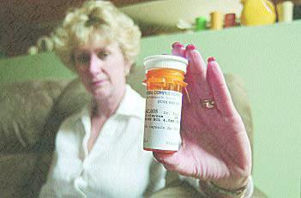
Naltrexone

Slide 39
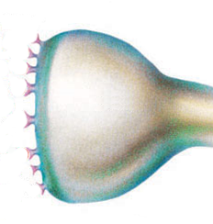
How Does Naltrexone Work?
Naltrexone is an opioid receptor antagonist and blocks opioid receptors.
N
= naltrexone
= opioids
N
N
By blocking opioid receptors, the “reward” and acute reinforcing effects from dopamine are diminished, and opioid consumption is reduced.
N
N
Post-Synaptic Neuron
N
Opioid
Receptor
N
N
N
39
Notes:
39
Purpose:
To depict the neuropathophysiology associated with increased likelihood for relapse
Key Points:
When the individual is exposed to stimuli previously associated with alcohol consumption (eg, the smell of alcohol, a bar environment, being offered a drink) the conditioned stimulus results in excess glutamate release within the brain reward circuits and limbic structures (emotion) which can generate feelings of depression, anxiety and dysphoria as well as the anticipation of alcohol. These feelings may precipitate relapse in a patient who is trying to maintain abstinence
Because conditioning is a very long-lasting phenomenon in the brain, these cue-induced, or alcohol-related conditioned behaviors can occur weeks, months or even years after physical withdrawal has dissipated completely
Source: Littleton J. Neurochemical mechanisms underlying alcohol withdrawal. Alcohol Health Res World.1998;22:13-24.

Slide 40
Research About Naltrexone for Opioids
Meta analysis of 7 studies.
Naltrexone lowered the risk of drug abuse better than placebo, with or without psychological support
This effect can be seen to fall off over time and may be of limited clinical significance.
Risk of reimprisonment seemed to decreased while on naltrexone therapy, but the number of participants was small.
Patient compliance is an issue that must be addressed
(Adi, et al., 2007)
40
Notes:
Meta analysis of 7 studies.
The results suggest that naltrexone as maintenance therapy for relapse prevention in opioid addicts may be better than placebo in terms of retention in treatment, but this was not statistically significant
Naltrexone lowered the risk of drug abuse in naltrexone significantly better than placebo, with or without psychological support However, this effect can be seen to fall off over time and may be of limited clinical significance.
Use of risk of reimprisonment seemed to decreased while on naltrexone therapy in two studies of parolees or people on probation, but the number of participants was small.
One of the major problems with use of naltrexone was patient compliance and steps should be taken in increase compliance
Adi, Y, Juarez-Garcia, A, Wang, D, Jowett, S, Frew, E., Day, E, Bayliss, S., Roberts, T, & Burls, A. (2007). Oral naltrexone as a treatment for relapse prevention in formerly opioid-dependent drug users: a systematic review and economic evaluation. Health Technology Assessessment, 11, 1-85.

Slide 41
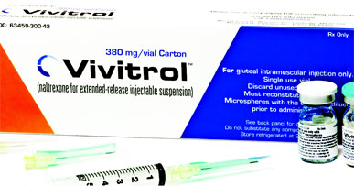
Naltrexone for Extended-Release Injectable Suspension
41

Slide 42
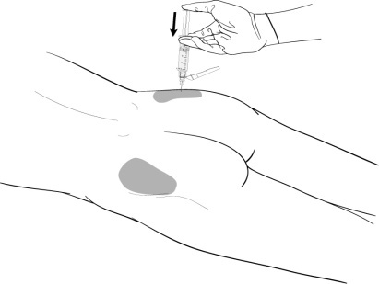
Extended-Release Naltrexone Administration
Amount: one 380mg injection
Method: deep muscle in the buttock
Frequency: every 4 weeks
Must be administered by a healthcare professional and should alternate buttocks each month.
42
Notes:
42

Slide 43
How Does Extended-release Naltrexone Work?
Extended-release naltrexone works in the brain exactly like oral naltrexone.
Blocks opioid receptors for one entire month compared to approximately 28 doses of oral naltrexone to receive the same longevity.
Since it is an intramuscular injection and not an implanted device, it is not possible to remove it from the body once extended-release naltrexone has been injected.
43
Notes:
43

Slide 44
Research About Extended-Release Naltrexone
When compared to placebo, those receivining extended release naltrexone:
Had fewer opioid positive urines
Stayed in treatment longer
Had less craving
Showed greater improvement in the mental component of quality of life and overall heatlh status
Krupitsky, et al., 2010
44

Slide 45
Four questions patients ask:
How is naltrexone better for me than heroin?
Is it better for me than the antagonists?
How long should I stay on naltrexone?

Slide 46
Pharmacotherapy in context: correct glossary
Abstinence includes pharmacotherapy
Maintenance, not substituion or replacement (new term also: MAT)
Tapering from maintenance, not detoxification, (also ‘medically supervised withdrawal’, or MSW)
Discontinuation, not discharge
Toxicology screens: pos/neg, not clean/dirty)

